Slide 1
3.3 Brownian Motion
報告者：陳政岳

Slide 2
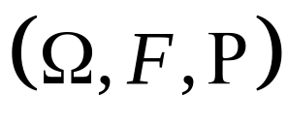

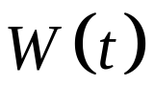

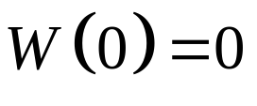

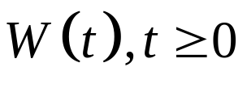
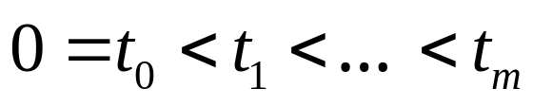
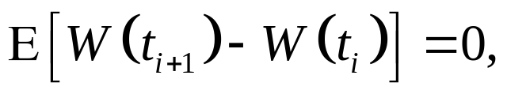
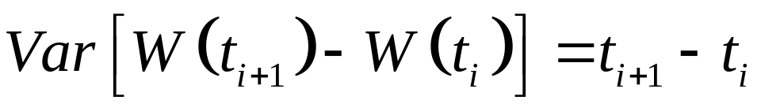
3.3.1 Definition of Brownian Motion
Definition 3.3.1
Let be a probability space. For each , suppose there is a continuous function of that satisfies and that depends on . Then , is a Brownian motion if for all
the increments
are independent and each of these increments is normally distributed with
.

Slide 3
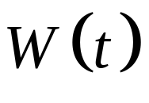
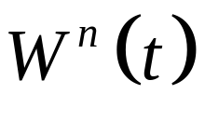
3.3.1 Definition of Brownian Motion
Difference Brownian motion and scaled random walk ：
Brownian motion：
1. Time steps are not linear.
2. Brownian motion is normal.
scaled random walk：
1. Time steps are linear.
2. Brownian motion is only approximately normal.

Slide 4
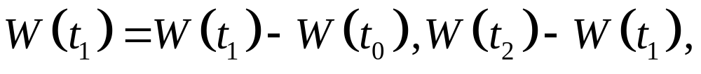
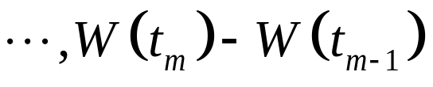
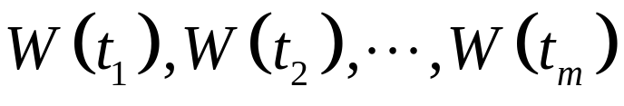
3.3.2 Distribution of Brownian Motion
The increments
are independent and normally distributed, the random variables
are jointly normally distributed. The joint distribution of jointly normal random variables is determined by their means and covariances.

Slide 5
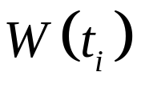
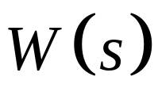
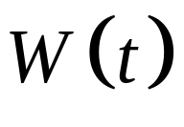
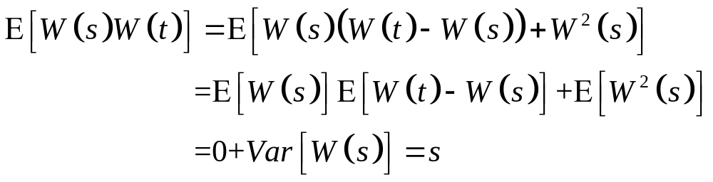
3.3.2 Distribution of Brownian Motion
1. has mean zero.
2. the covariance of and ：

Slide 6
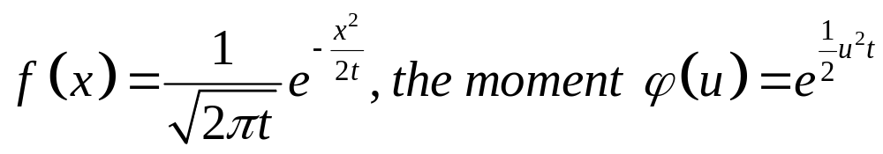
3.3.2 Distribution of Brownian Motion
The moment-generating function of this random vector can be computed using the moment-generating function for a zero-mean normal random variable with variance t and the independence of the increments.
Ps. the moment-generating function

Slide 7
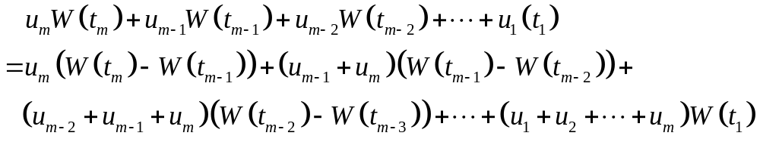
3.3.2 Distribution of Brownian Motion

Slide 8
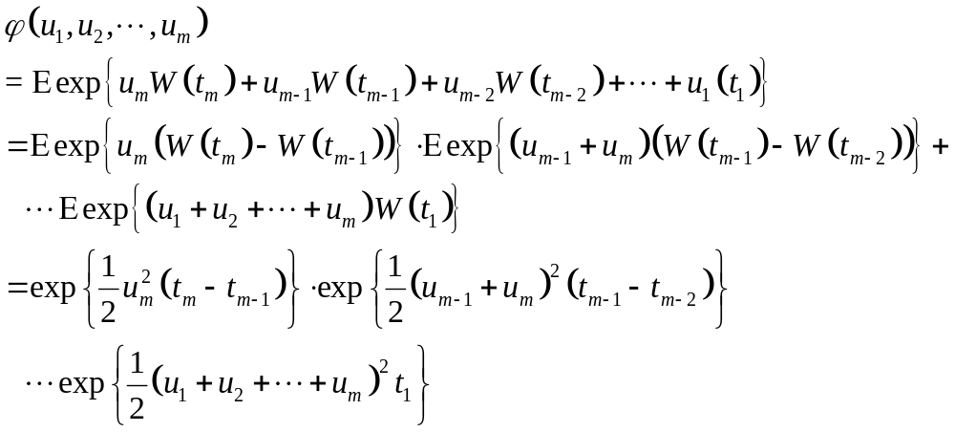
3.3.2 Distribution of Brownian Motion

Slide 9
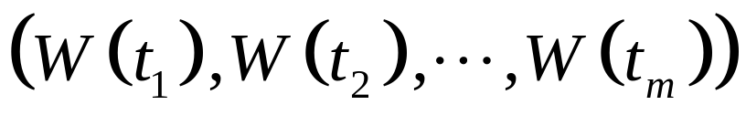
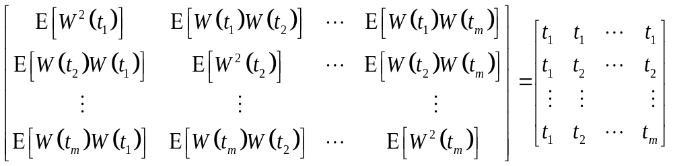
3.3.2 Distribution of Brownian Motion
The covariance matrix for Brownian motion ( i.e., for the m-dimensional random vector
) is

Slide 10
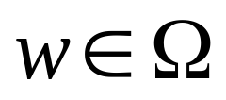
3.3.2 Distribution of Brownian Motion
Theorem 3.3.2 (Alternative characterizations of Brownian motion)
Let be a probability space. For each
, suppose there is a continuous function
of that satisfies and that depends on . The following three properties are equivalent.

Slide 11
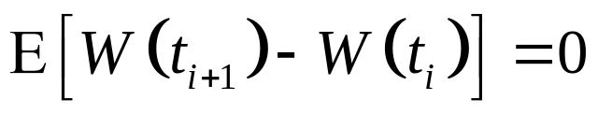
3.3.2 Distribution of Brownian Motion
For all , the increments
are independent and each of these increments is normally distributed with mean and variance given by
and
.

Slide 12
3.3.2 Distribution of Brownian Motion
For all , the random variables are jointly normally distributed with means equal to zero and covariance matrix.
For all , the random variables have the joint moment-generating function.

Slide 13
3.3.2 Distribution of Brownian Motion
If any of 1, 2, or 3 holds ( and hence they all hold), then is a Brownian motion.

Slide 14
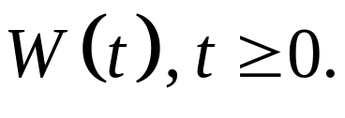
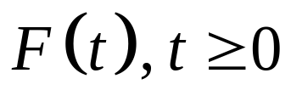

3.3.3 Filtration for Brownian Motion
Definition 3.3.3
Let be a probability space on which is defined a Brownian motion A filtration for the Brownian motion is a collection of -algebra satisfying：

Slide 15
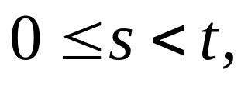
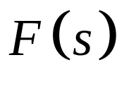
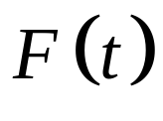
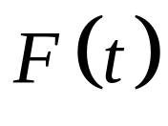
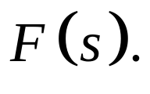
3.3.3 Filtration for Brownian Motion
( Information accumulates ) For every set in is also in . In other words, there is at least as much information available at the later timeas
there is at the earlier time

Slide 16
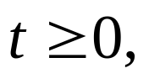
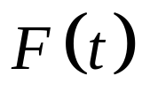
3.3.3 Filtration for Brownian Motion
( Adaptivity ) For each the Brownian motion at time t is -measurable. In other words, the information available at time t is sufficient to evaluate the Brownian motion at that time.

Slide 17

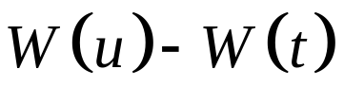
3.3.3 Filtration for Brownian Motion
( Independence of future increments ) For the increment is independent of . In other words, any increment of the Brownian motion after time t is independent of the information available at time t.

Slide 18
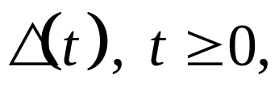
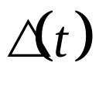


3.3.3 Filtration for Brownian Motion
Let be a stochastic process. We say that is adapted to the filtration if for each the random variable is
-measurable.

Slide 19
There are two possibilities for the filtration F(t) for a Brownian motion：
F(t) contain only the information obtained by observing the Brownian motion itself up to time t.
F(t) information obtained by observing the Browning motion and one or more other process.

Slide 20
Theorem 3.3.4
Brownian motion is a martingale.

